Slide 1

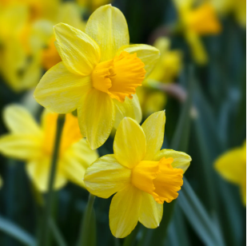
WVGCI Spring Conference 2025: “Swing into Spring”
How to have a program on Daffodils at a Garden Club Meeting
Daffodils are one of the first flowers to bloom in the Spring, bringing hope and anticipation that Winter is coming to an end. The little slivers of green foliage poking out of the soil/snow makes me smile and reminds me that warmer and longer days are coming soon. This Winter has been challenging with below freezing temperatures for multiple days and record snowfall totals. We cannot deny that Winter has many gardening benefits like natural pest control, improved soil structure due to freeze-thaw affects, and a much-needed period of rest for our gardens. The hope of Spring being just around the corner is exciting! As a perennial, daffodils can tolerate the snow and can be left in the ground with minimal care. Typically, daffodil bulbs are planted in the Fall when the soil is still cool and workable, but with hope being our theme, let’s get these beauties in the ground before our last frost and say a little blessing.
Purpose and Goal: Promote a program that highlights Daffodils in our local community
Activity Possibilities:
Garden Clubs to collect member-donated bulbs (1-2 bulbs/member) or purchase with club funding
Schedule a garden club tour at a local flower/greenhouse/garden and request daffodil bulb donations or purchase
Organize and promote a community bulb swap
Steps for Spring Activities:
Inspect all bulbs to ensure viability for quick planting before your last frost
Explore high-traffic locations in your community where daffodils can be planted and flourish (i.e., post office, library)
Create signage that highlights your club and the local businesses that participated
Document location and take pictures (before & after) … especially when they bloom!
Steps for Fall/Winter Activities:
Cut back leaves after they’ve turned brown and died
Mulch lightly with straw and wait patiently for Spring

