Slide 1
Roses

Slide 2
"A rose by any other name would smell as sweet“ - William Shakespeare
A rose is a woody, perennial, flowering plant in the genus Rosa.
Characteristics:
  Size
  Leaves
  Fruit
  Thorns
  Bloom
Notes:
Size - 8 in – 33 ft
Leaves – 3, 5, 7 leaflets
Fruit - Rose Hip – red, orange, purple, black
Thorns – most have
Bloom 5 major types Pointed, Rosette, quartered, Balloon, Round

Slide 3
History
Fossil evidence 35 million years
Cultivation 5000 years ago
Ancient (3000 BC – 50 AD)
  Mesopotamia
  Roman Empire
  Egyptian Empire
Middle Ages (50 – 1450)
  Cultivation
  Medicinal
  Holy festivals
Early Modern Period (1450 – 1867)
  War of Roses
  Josephine Bonaparte
  Flower Shows
  New Techniques in Breeding
  Development of Industry
Notes:
Fossil evidence all over the world including Colorodo
Mesopotamia – records of gathering roses during expeditions
Roman Empire – using them on statues, buildings
Egyptian – used in funeral services and own tombs ; used in the worship of the goddess Isis
Middle Ages
- first signs of large cultivation in france
-
Early Modern Period
War of the Roses – House of Lancaster / York fight for control of England – symbols red and white rose
Josephine Bonaparte – interested in botany, collected over 250 species of roses; impetus for expansion of breeding program
Flower Shows to display and judge
Drove development of new techniques primarily ability to cross pollinate and create new breeds via seed
Many rose classes were created during this time - but with out the desired trait of reblooming
In 1867 – La France was created with reblooming characteristics – first Hybrid Tea
This represents a break in rose development all roses created until this time or considere Old Roses, Old Garden Roses, Antique Roses
Everything after this point is consider a modern rose

Slide 4
History
Modern Period (1867 – current)
  Until 1990’s
    Perfect long stem rose
    Intense color
    High Maintenance
    Did not play well with others
  1990’s on
    Move away from “florist” rose goal
    Disease resistance
    Landscape Roses
Notes:
While many new roses were introduced they had the same basic shape and were high maintenance. My grandmothers roses would have looked very much like my roses until the 1990’s. A typical rose bed was dedicated to roses, for optimum performance required timed pruning, spraying and fertilizing.
This is not from any literature; but in the 1990’s the industry changed
Breeders began to move away from the goal of producing the perfect florist rose in the home garden.
They stopped spraying programs and looked for disease resistant varieties.

Slide 5
Rose Industry
Cut Flowers
  Global Industry
  3 Major Components
  US Production
Rose Bushes
  Breeders/Growers
  Graft / Own Root
  Immergence of Disease Resistance Bushes
Notes:
Global Insdustry
Floriculture began in England in the 19th century on vast estates
Traditionally the center of flower production was near the developed world, in Japan, Netherlands and North America
There is a shift to countries with favorable climates and low cost labor.
Today in is a dynamic global industry that is successfully bring better jobs into 3rd world countries
The largest exporter of cut roses is Ecuador, followed by Columbia. The US imports more than 82% of its cut flowers.
In the 1950’s global floral trade was less than 3 billion
By 2003 it had expanded to 102 billion dollars annually
3 Major Components
- growers
- wholesalers
- retailers
However the structure is being challenged by the internet, looking to go direct to retailers – lower over all cost
US production has continued to decline due to
larger flowers , better color and low cost of imports
Walmart and other big chains also put pressure on the market
Most US production is centered in California
Most rose bushes that you buy are grown in the US
Cottage industry around Heirloom business
Could not find any financial data on rose bushes.
-

Slide 6
Rose Breeders – Modern Roses
David Austin
Weeks Roses
Star Roses
Jackson & Perkins
Kordes Roses
Meilland International
Buck
Will Radler
Notes:
David Austin – British – modern English roses
Kordes – Netherlands
Buck – 1947 started looking for an easy to grow rose in Ames Iowa
Will Radler – Knock out rose – revolutionized the use of roses in the landscape

Slide 7
Old Garden Roses - Savers
Antique Rose Emporium
Heirloom Roses
High Country Roses
Rogue Valley Roses

Slide 8
Own Root / Grafted Roses
Own Root Roses
  Better Cold resistance
  Better Disease Resistance
  Does not lose graft
Grafted Roses
  Dr. Huey
  fortuniana
  Multi Flora Rose – 1940’s
  Better Color
  Stronger growth due to improve root system
  Where to plant the root ball
Notes:
This is a hotly debated topic with both sides claiming
better
I stopped straying and replaced all my hybrid teas in about 2002.
I also went to own root roses and that has continued to be my preference.
I don’t have enough experience in WV to make any type of recommendation.

Slide 9
Multiflora Rose
Overview
IPM Strategies
Used as a root stock 1860-1930’s
Used by USDA Soil Conservation for erosion control and Highway Departments
Prolific
Classified as a noxious weed
Host for eriophyid mite
Cultural Controls - Don’t Plant
Mechanical Controls – Dig it out
Biological Controls – Not Commercially available
Chemical Controls – Herbicides
Rose Rosette Disease
Carried by eriophyid mite
Attacks roses
No General IPM Strategies
Kills the plant
Notes:
Local problem all roses at heritage park infected
On trip to Houston saw roses affected from WV to Chattanooga reported cases all over the southeast/northeast/midwest

Slide 10
Earthkind Roses - TAMU
Program
8 years of field trials
Zones 7-10
Notes:
Didn’t want to end on a bad note for roses
Texas A&M has a program to identify roses hardy and disease free
Xx roses have received this designation and what I would mainly grow in Houston
The bad news is the program only test for zones 7-10.

Slide 11
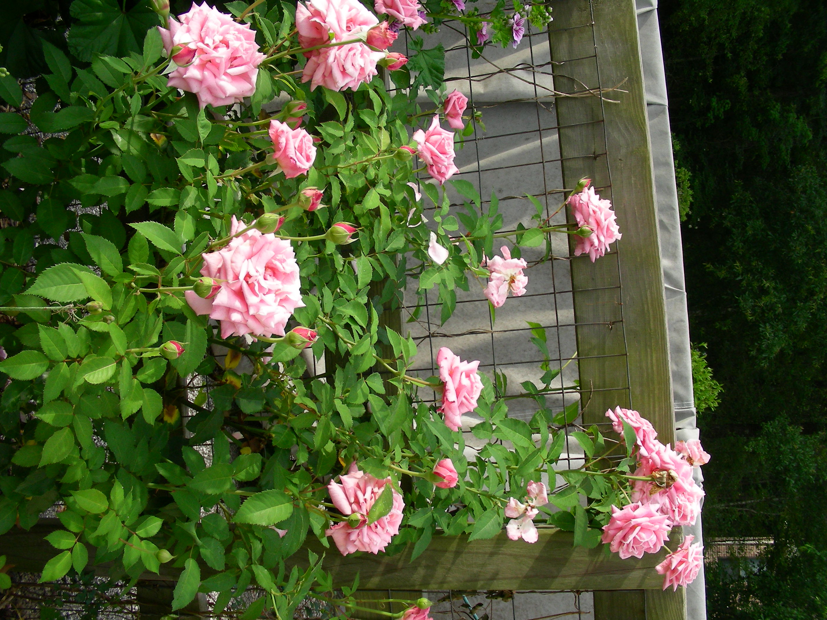
Belinda’s Dream

Slide 12
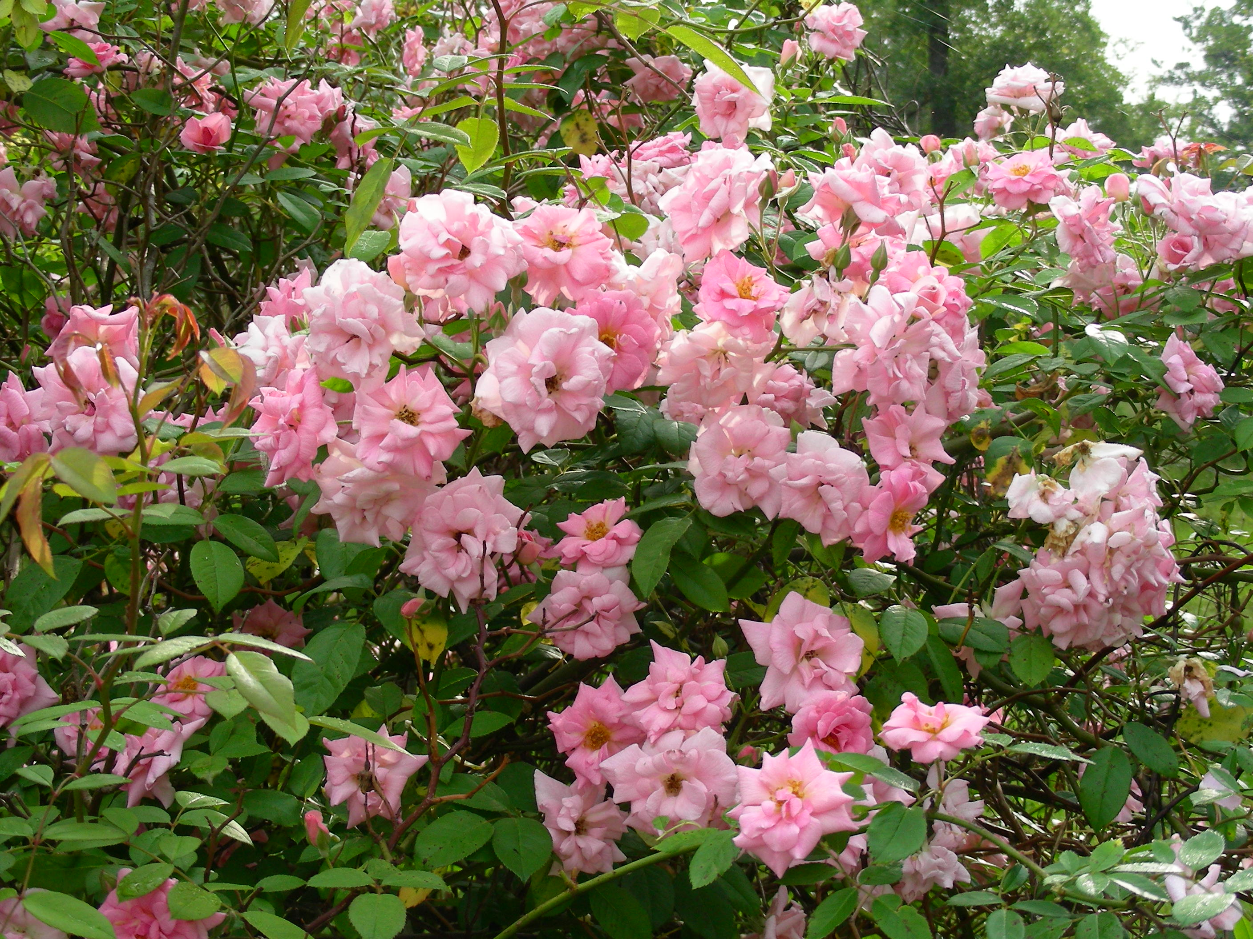
Climbing Pinkie

Slide 13
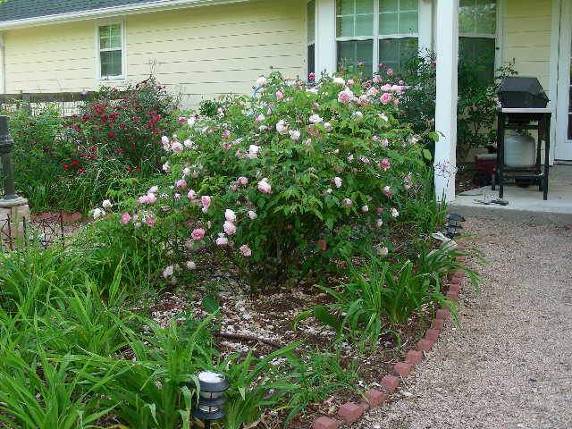
Duchess de Brambant

Slide 14
